Slide 1
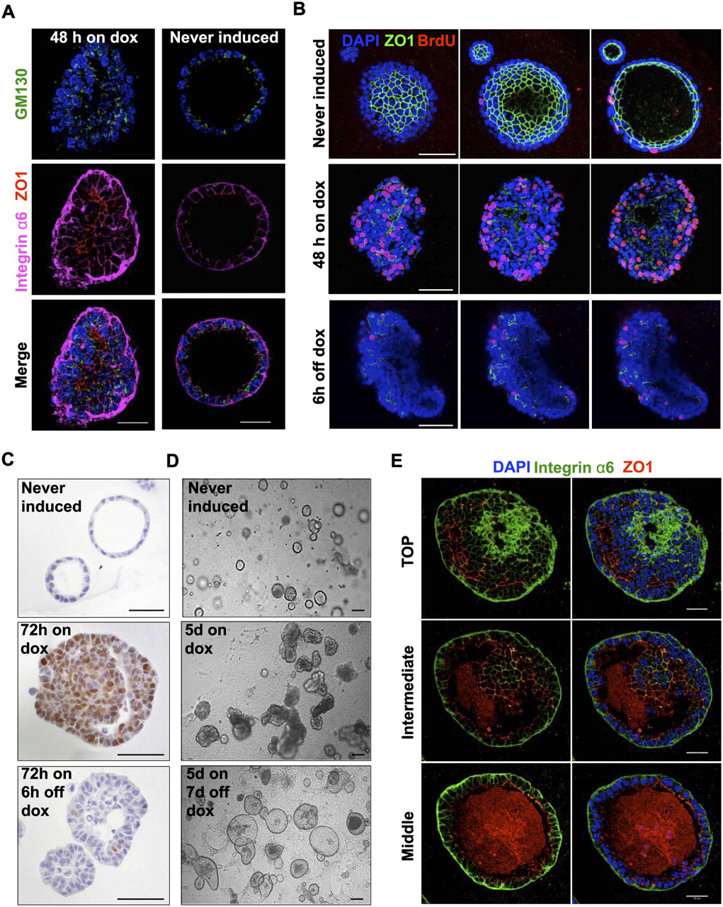

Doxycycline exposure causes loss of epithelial polarity and induces proliferation; weaning from doxycycline results in survival of a repolarized cell layer.
Jechlinger M et al. Genes Dev. 2009;23:1677-1688
©2009 by Cold Spring Harbor Laboratory Press
Notes:
Doxycycline exposure causes loss of epithelial polarity and induces proliferation; weaning from doxycycline results in survival of a repolarized cell layer. (A) Confocal microscopy shows loss of epithelial cell polarity in an acinus grown from tritransgenic cells and exposed to doxycycline for 48 h. (Left panels) Five-micron projection through the middle of the sphere (doxycycline exposure 48 h). (Right panels) Five-micron projection through the middle of an acinus that had never been exposed to doxycycline. (Blue) DAPI stain; (green) GM130 (Golgi protein, apical marker); (red) ZO1 (tight junctions, apical); (magenta) Integrin α6 (basolateral). Bar, 30 μm. (B) Confocal microscopy shows high number of BrdU-incorporating cells in tritransgenic spheres exposed to doxycycline and lower number of BrdU-incorporating cells for tritransgenic acini that were never induced with doxycycline or weaned from doxycycline. Three adjacent sections (covering 5 μm each) for each doxycycline status are shown for a representative sphere; spheres were exposed to BrdU for 1 h, before fixation. (Top panels) Polarized tritransgenic acinus that was never exposed to doxycycline. (Middle panels) Tritransgenic sphere exposed to doxycycline for 48 h. (Bottom panels) Tritransgenic sphere exposed to doxycycline for 72 h and weaned from doxycycline for 8 h. (Blue) DAPI stain; (green) ZO-1; (red) BrdU. Bar, 40 μm. (C) Pictures of immunostaining for Myc protein show regulation of the transgene tightly correlated to the doxycycline status of the spheres grown from tritransgenic primary mammary cells. (Top panel) Polarized acinus that was never exposed to doxycycline. (Middle panel) Sphere exposed to doxycycline for 72 h. (Bottom panel) Sphere exposed to doxycycline for 72 h and weaned from doxycycline for 6 h. Bar, 50 μm. (D) Bright-field pictures show a typical field with representative spheres grown from tritransgenic primary mammary cells. (Top panel) Hollow acini (grown without doxycycline for 18 d). (Middle panel) Filled, irregular-shaped spheres (cells grown into acini for 6 d, then induced with doxycycline for 5 d). (Bottom panel) Hollow, irregular-shaped spheres that show debris of internal cells (cells grown into acini for 6 d, induced with doxycycline for 5 d, and then deinduced for 7 d). Bar, 50 μm. (E) Confocal microscopy shows a typical repolarized single-cell-layered sphere that survives doxycycline withdrawal. Tritransgenic primary mammary cells were grown into acini for 6 d, induced with doxycycline for 5 d, and then grown without doxycycline for 7 d. Three projections (covering 3 μm of depth each) are shown. (Top) panels) Top level. (Middle panels) Intermediate level. (bottom panels) Sections through the middle of the sphere. (Blue) DAPI stain; (green) Integrin α6; (red) ZO1. Bar, 30 μm.

